Slide 1
Building dashboards with Plotly and Dash

Slide 2
Outline
Introduction to Plotly
Charts in Plotly
Introduction to Dash
App structure in Dash
Layout and Interactivity and Callbacks
Practical Examples

Slide 3
What is plotly ?
Plotly is a Python library used for creating interactive, web-based visualizations.
It supports a wide range of charts and plots, including line graphs, scatter plots, and 3D graphs.
Its ultimate strength lies in the ability to build visually appealing, dynamic graphics that can be easily integrated into web applications and dashboards.

Slide 4
plotly.express module
The plotly.express module (usually imported as px) contains functions that can create entire figures at once, and is referred to as Plotly Express or PX.
Every Plotly Express function uses graph objects internally and returns a plotly.graph_objects.Figure instance.
Any figure created in a single function call with Plotly Express could be created using graph objects alone, but with between 5 and 100 times more code.

Slide 5
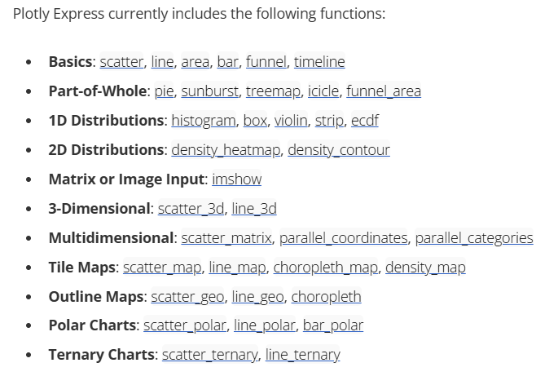
Plotly Express currently includes the following functions:
https://plotly.com/python/plotly-express/

Slide 6
Scatter, Line, and Bar Charts
px.scatter()
data_frame
x
y
color
size
facet_row
facet_col
title
labels
template
height
width
animation_frame

Slide 7
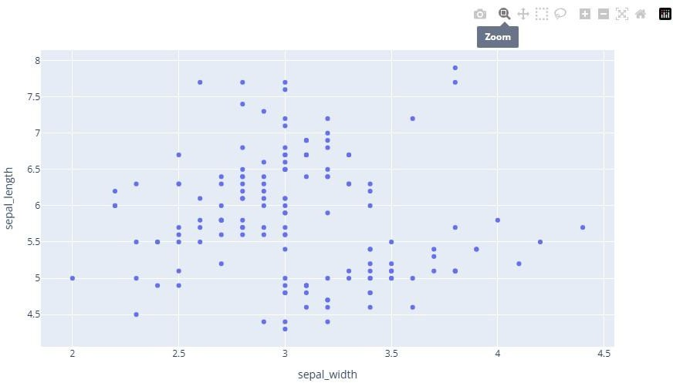
df = px.data.iris()
fig = px.scatter(df, x="sepal_width", y="sepal_length") fig.show()

Slide 8
Setting size and color with column names :
Scatter plots with variable-sized circular markers are often known as bubble charts
Note that color and size data are added to hover information. You can add other columns to hover data with the hover_data argument of px.scatter
import plotly.express as px df = px.data.iris()
fig = px.scatter(df, x="sepal_width", y="sepal_length", color="species", size='petal_length', hover_data=['petal_width'])
fig.show()

Slide 9
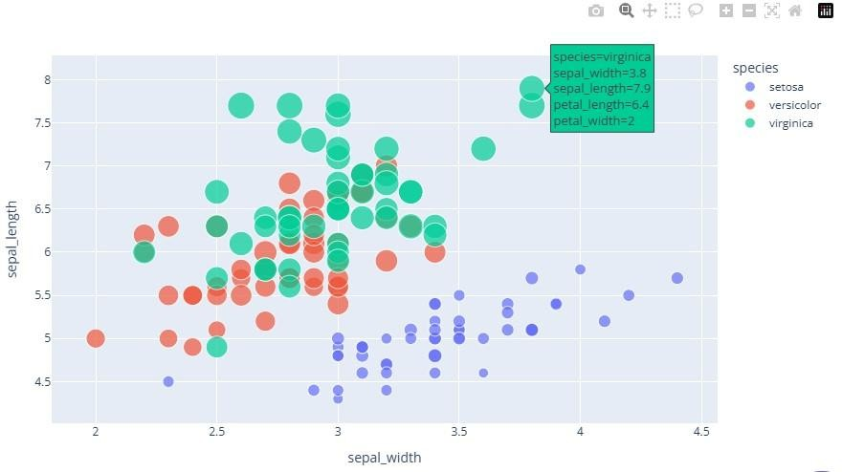

Slide 10
2. px.line()
data_frame
x
y
color
size
facet_row
facet_col
title
labels
template
height
width
animation_frame
line_shape
range_x
range_y
line_color

Slide 11
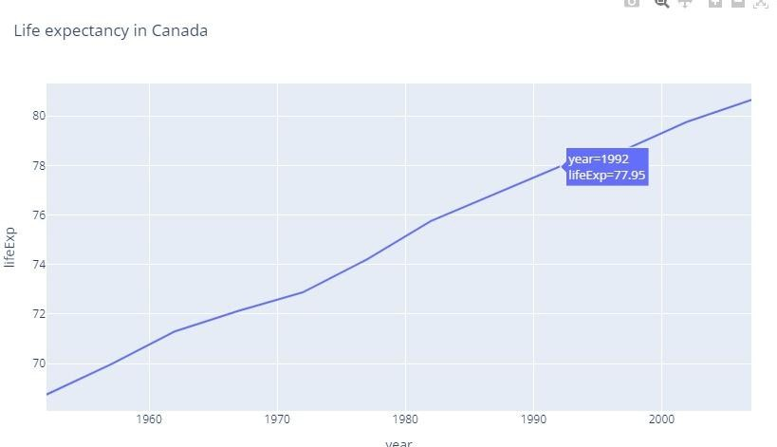
df = px.data.gapminder().query("country=='Canada'")
fig = px.line(df, x="year", y="lifeExp", title='Life expectancy in Canada') fig.show()

Slide 12
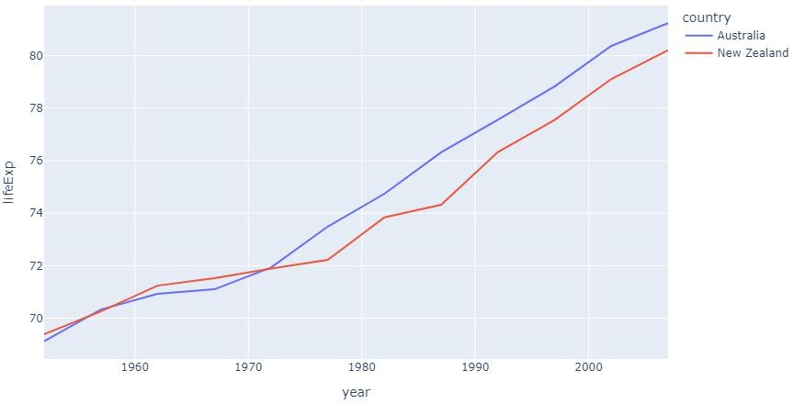
df = px.data.gapminder().query("continent=='Oceania'") fig = px.line(df, x="year", y="lifeExp", color='country') fig.show()

Slide 13
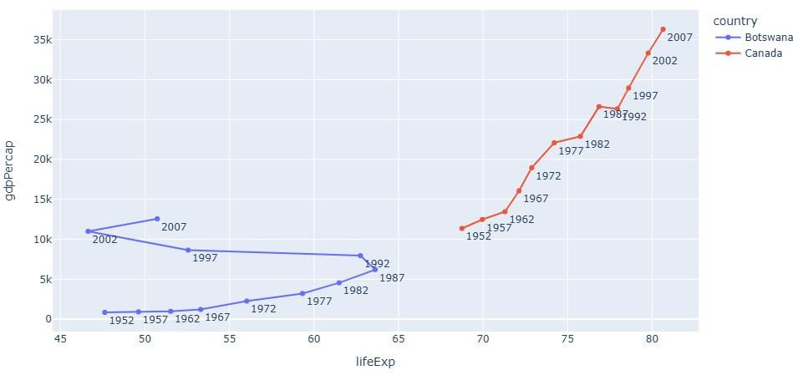
fig = px.line(df,x="lifeExp",y="gdpPercap",color="country",text="year") fig.update_traces(textposition="bottom right")
fig.show()

Slide 14
3. px.bar()
data_frame
x
y
color
size
facet_row
facet_col
title
labels
template
height
width
animation_frame
barmode

Slide 15
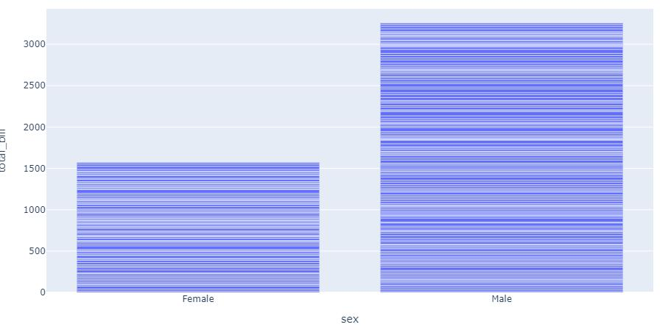
df = px.data.tips()
fig = px.bar(df, x="sex", y="total_bill") fig.show()

Slide 16
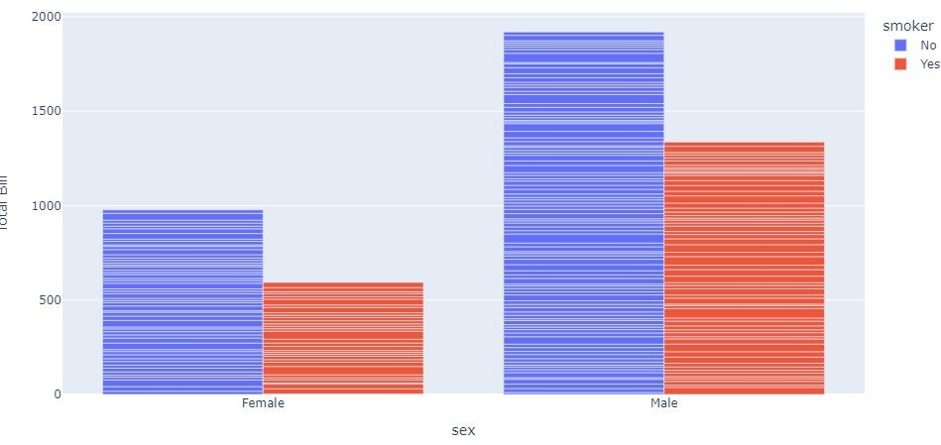
df = px.data.tips()
fig = px.bar(df,x="sex",y="total_bill",color="smoker",barmode="group") fig.show()

Slide 17
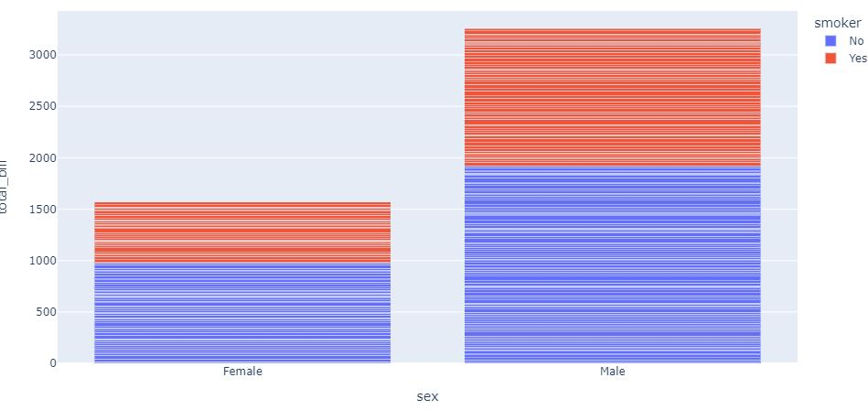
df = px.data.tips()
fig = px.bar(df, x="sex", y="total_bill", color="smoker", barmode="stack") fig.show()

Slide 18
1-D destribution
px.histogram()
data_frame
x
y
color
barmode
nbins
title
labels
template
height
width
range_x
range_y

Slide 19
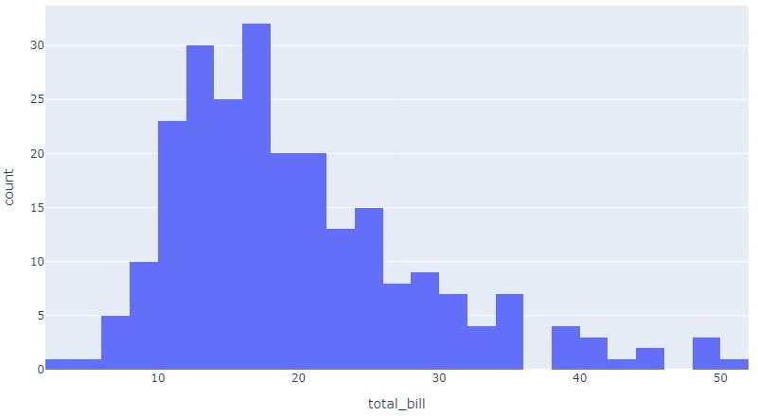
Numerical data
df = px.data.tips()
fig = px.histogram(df, x="total_bill") fig.show()

Slide 20
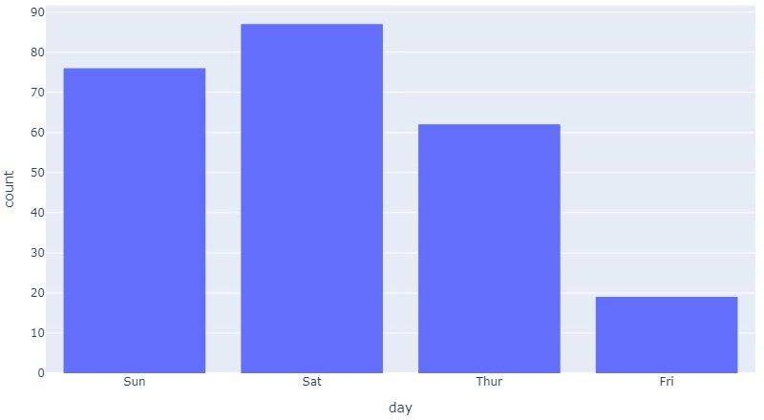
Categorial data
df = px.data.tips()
fig = px.histogram(df, x="day") fig.show()

Slide 21
2. px.box()
data_frame
x
y
color
size
facet_row
facet_col
title
labels
template
height
width
animation_frame

Slide 22
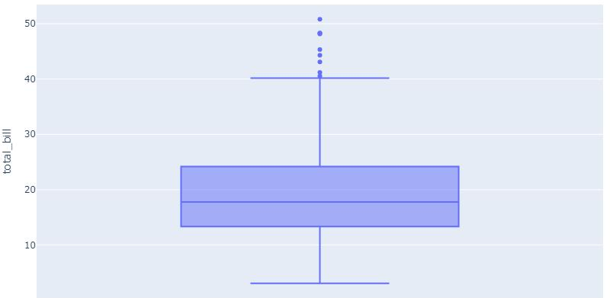
df = px.data.tips()
fig = px.box(df, y="total_bill") fig.show()

Slide 23
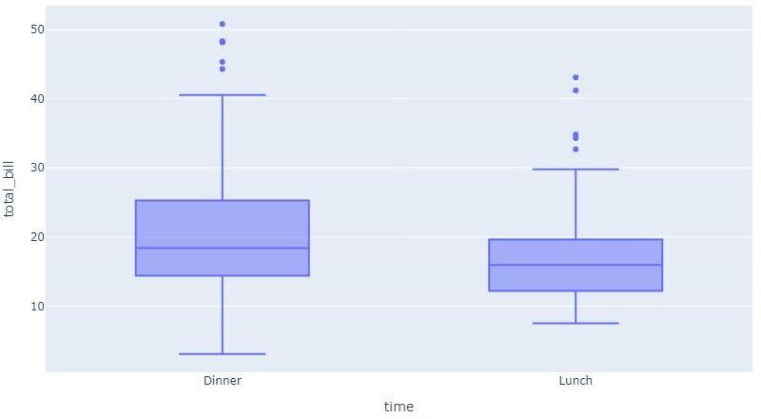
df = px.data.tips()
fig = px.box(df, x="time", y="total_bill") fig.show()

Slide 24
Practical Work in:
1_Plotly_Basics.ipynb
2_Plotly_Basics.ipynb

Slide 25
Dash Framework

Slide 26
What is Dash?
Dash is a Python framework for building interactive web applications, particularly for data visualization and analytics
No need for deep knowledge of HTML, CSS, or JavaScript.
Ideal for data visualization and dashboards.

Slide 27
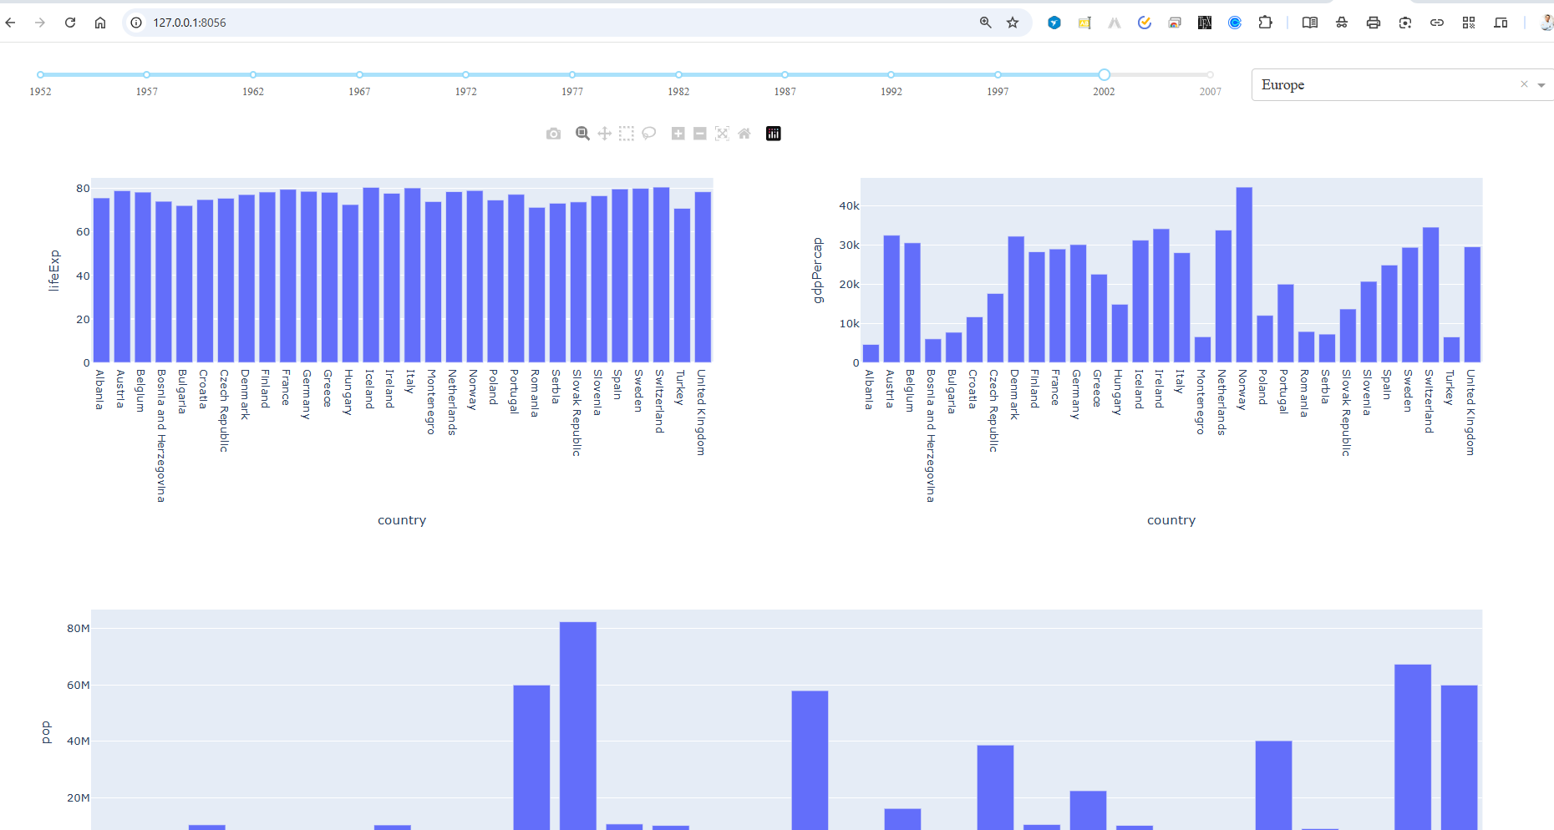
Key Technologies Behind Dash
Flask: Handles the backend server.
React.js: Manages the interactive frontend.
Plotly.js: Enables advanced data visualization.

Slide 28
Why Use Dash?
Simplifies web development for Python users.
Supports dynamic and interactive UI components.
Easily integrates with data science workflows.

Slide 29
https://plotly.com/python/plotly-express/#plotly-express-in-dash

Slide 30
App structure in Dash
Every Dash application has four prime components:
App instance
Layout
Callback function ( Optional )
app.runserver()

Slide 31
Layout
Core components
from dash import dcc
HTML components
from dash import html

Slide 32
Core components :
Higher-level interactive components that are generated JavaScript , CSS and HTML through react.js
Slider , input area , check items , datepicker and more
HTML components :
Component for each html tag
Key-word arguments describe the HTML attributes like Style , ClassName and id

Slide 33
HTML components :
Dash is a web app framework that provides pure Python abstraction around HTML, CSS, and JavaScript.
Instead of writing HTML or using an HTML templating engine, you compose your layout using Python with the Dash HTML Components module (dash.html).

Slide 34
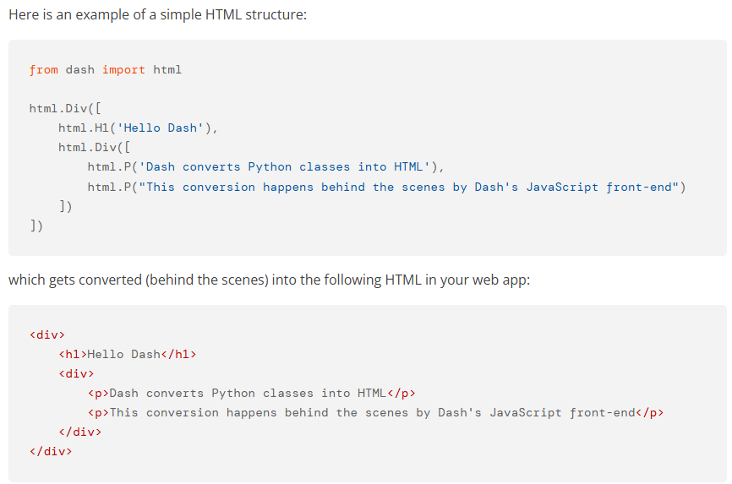
Dash HTML Components
https://dash.plotly.com/dash-html-components

Slide 35
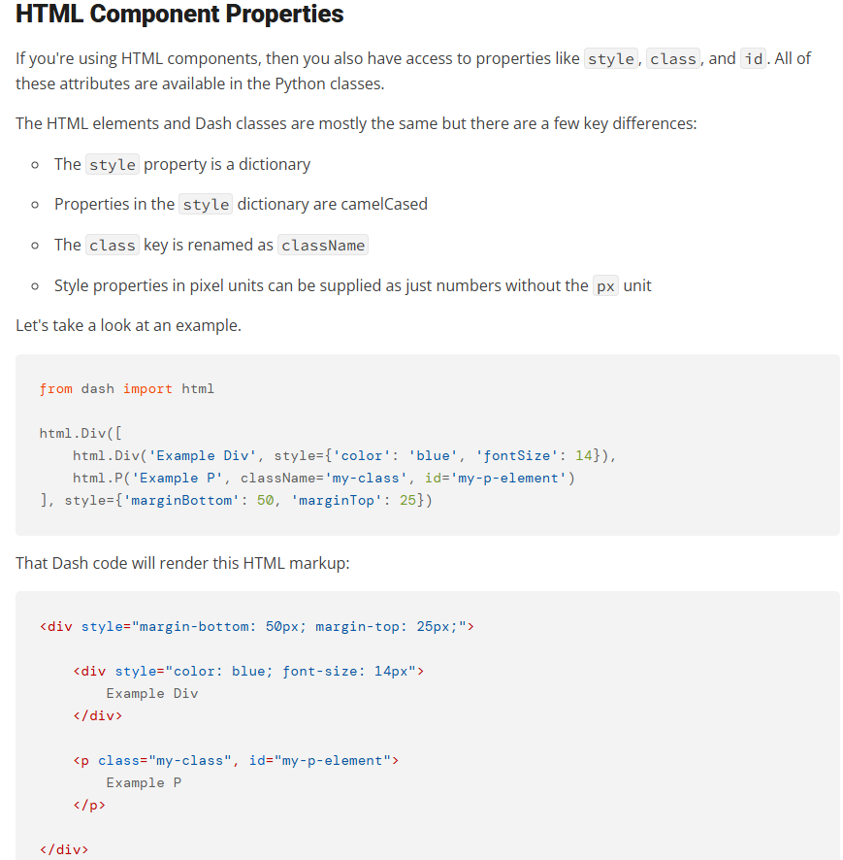

Slide 36
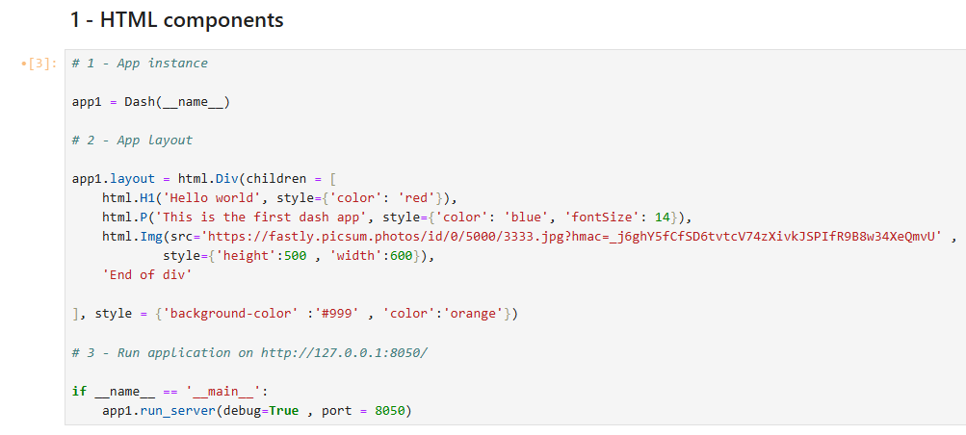

Slide 37
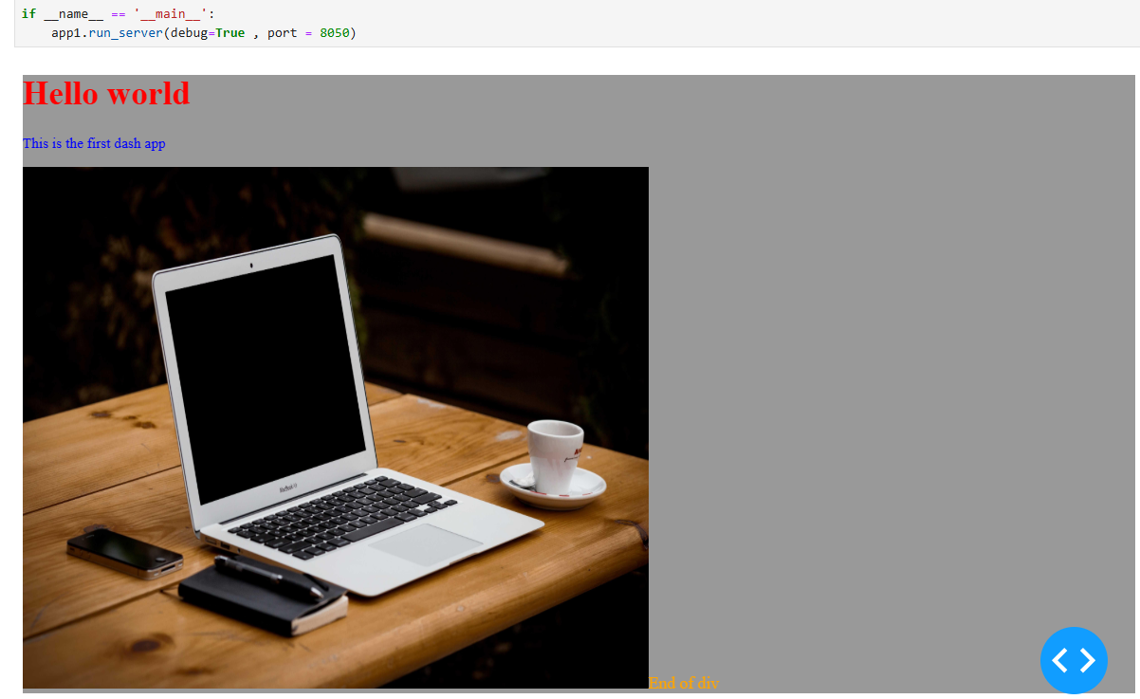

Slide 38
Core components :
Dash ships with supercharged components for interactive user interfaces.
The Dash Core Components module (dash.dcc) gives you access to many interactive components, including dropdowns, checklists, and sliders.

Slide 39
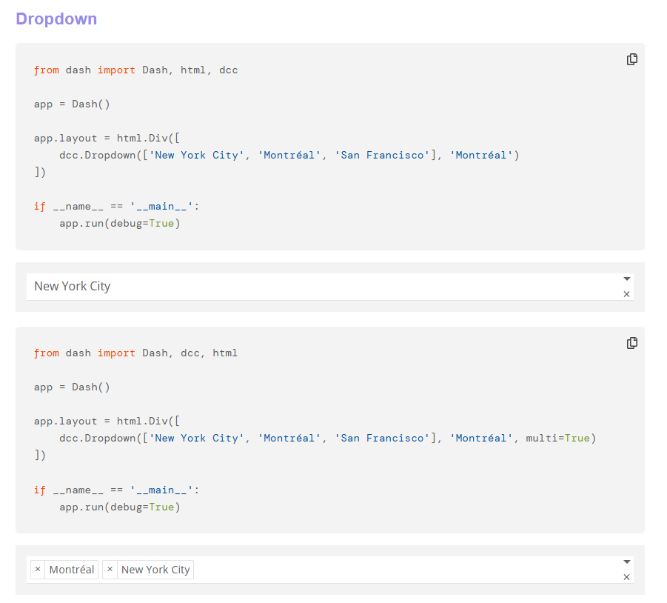

Slide 40
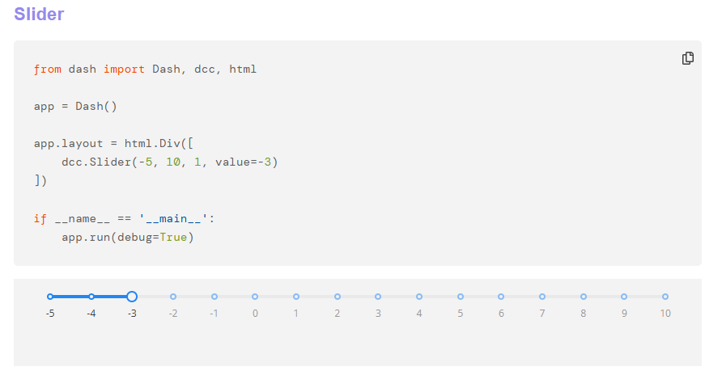

Slide 41
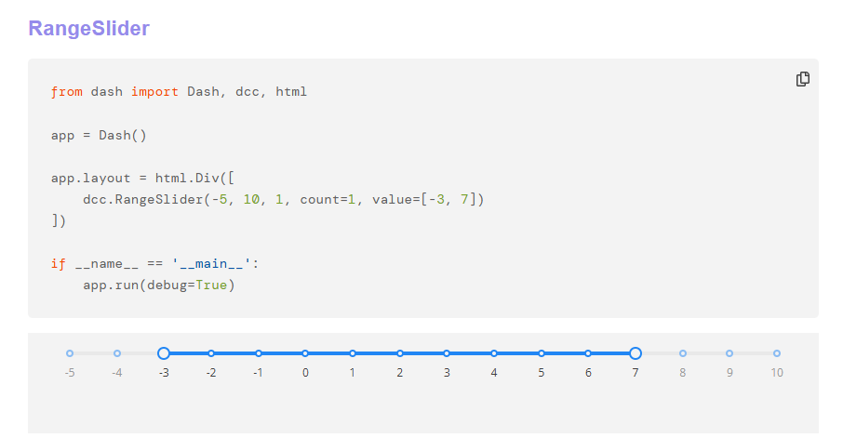

Slide 42
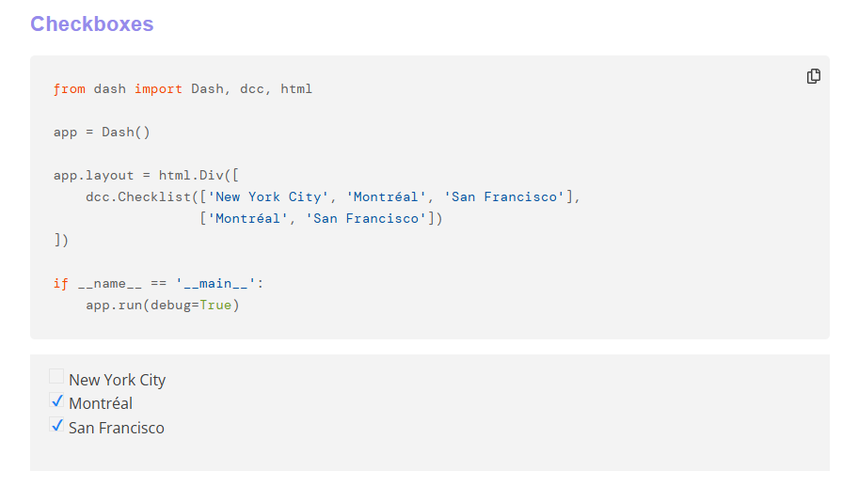

Slide 43

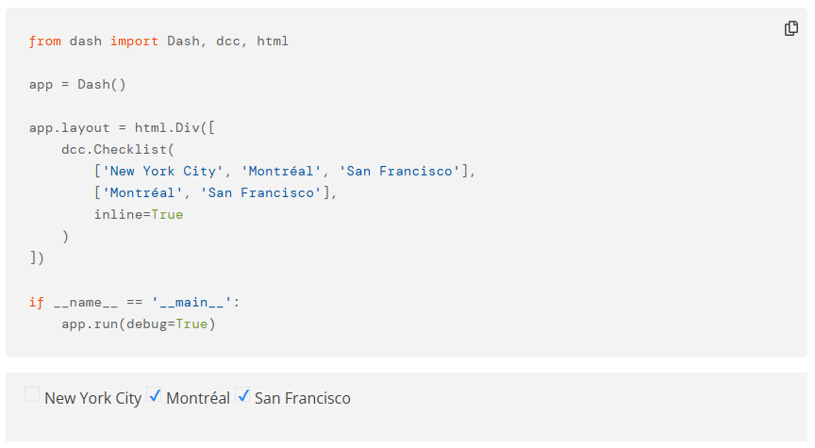

Slide 44
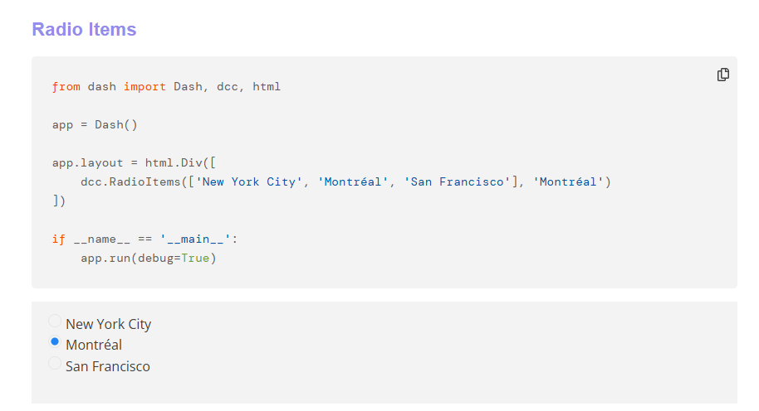

Slide 45
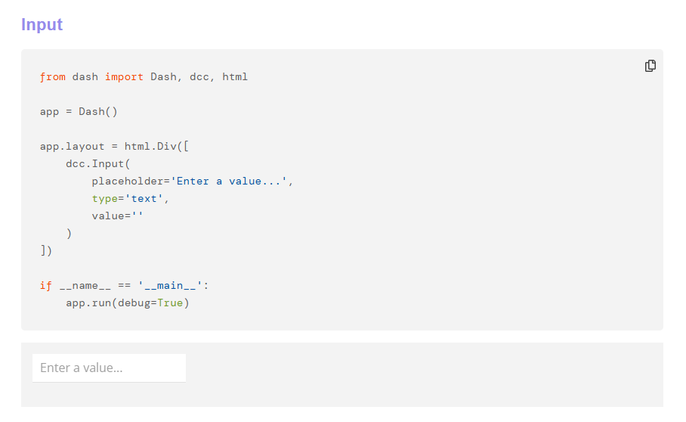

Slide 46
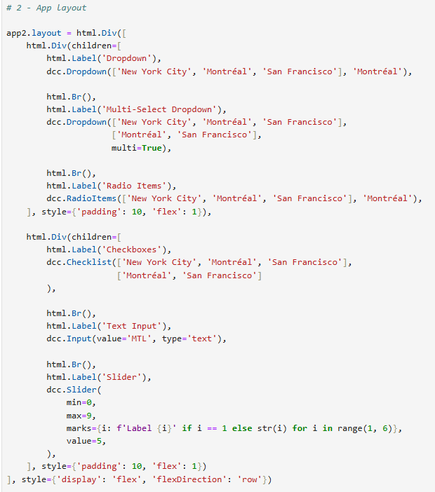
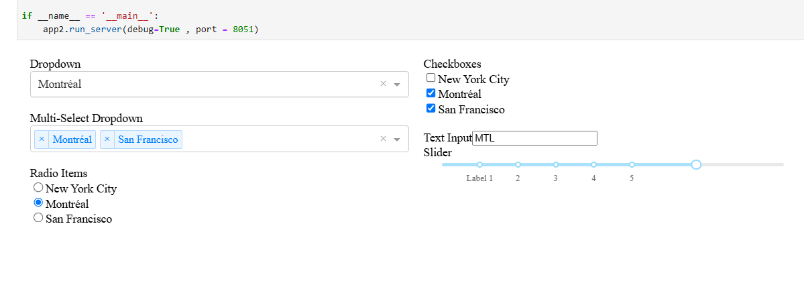

Slide 47
Interactivity with Callback function
Python function that is automatically called by Dash whenever an input component’s property changes
Decorated with @app.callback Decorator
Takes parameters as many as inputs
Perform operations to return the desired result for the output component
Return values as many as inputs

Slide 48
Callback function structure :
@app.callback(Output , Input , State)
def callback_function :
...
return result
Output : Sets results returned from callback to a component id
Input : Sets input that is provided to a callback function to a component id State : Like input but doesn’t trigger the function

Slide 49
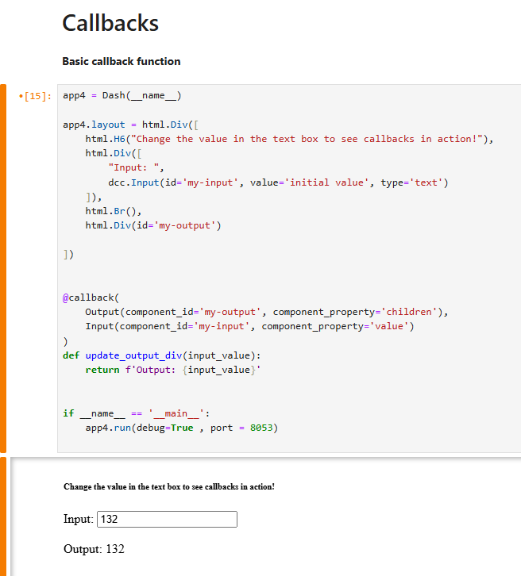
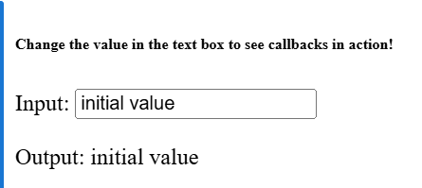
Update text when write immediately

Slide 50
Update text when write immediately

Slide 51
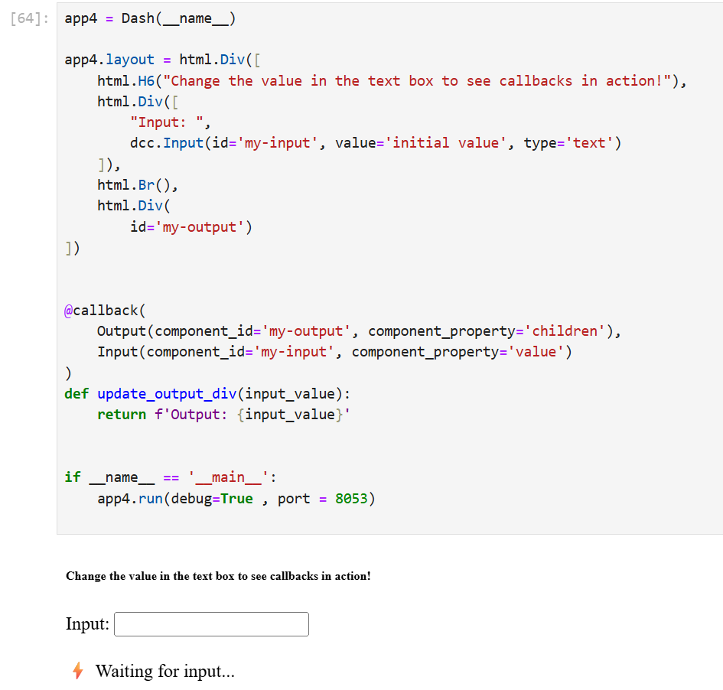

Slide 52
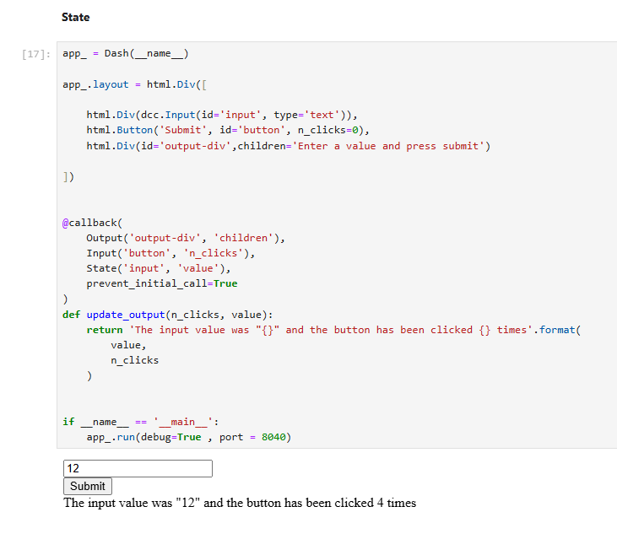
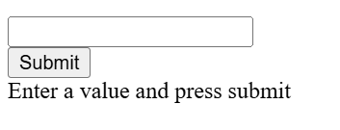
Use State: Prevent immediate update
In some cases, we want to take user input but not trigger the update immediately.
Instead, we update the output only when a button is clicked. This can be achieved using State in Dash.

Slide 53
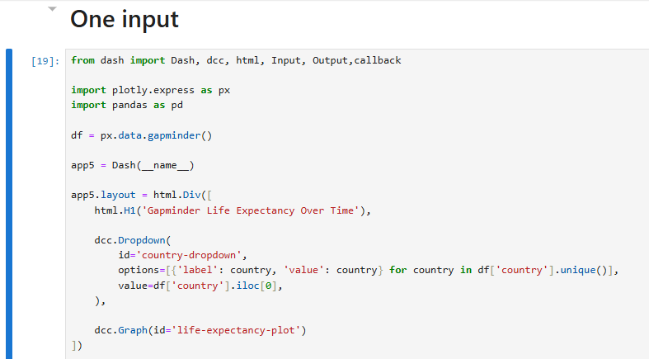
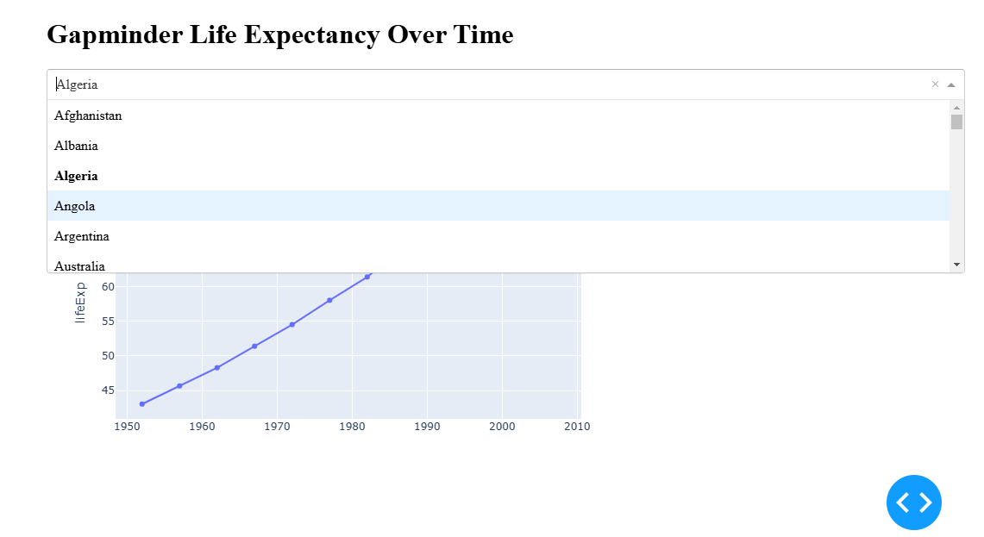

Slide 54
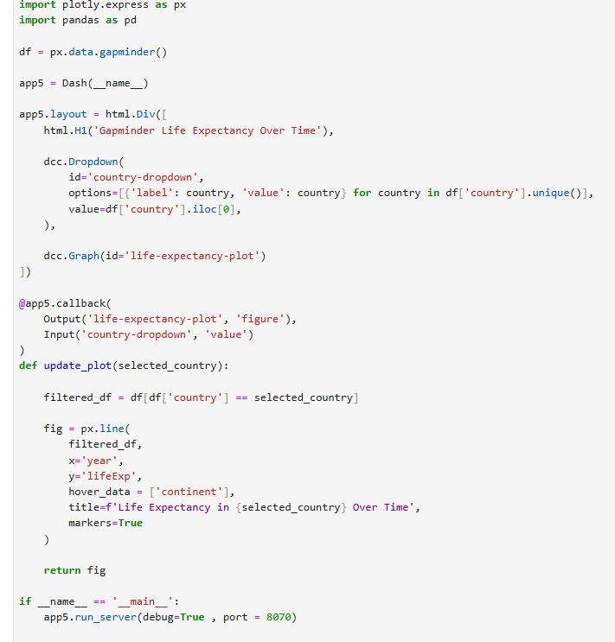
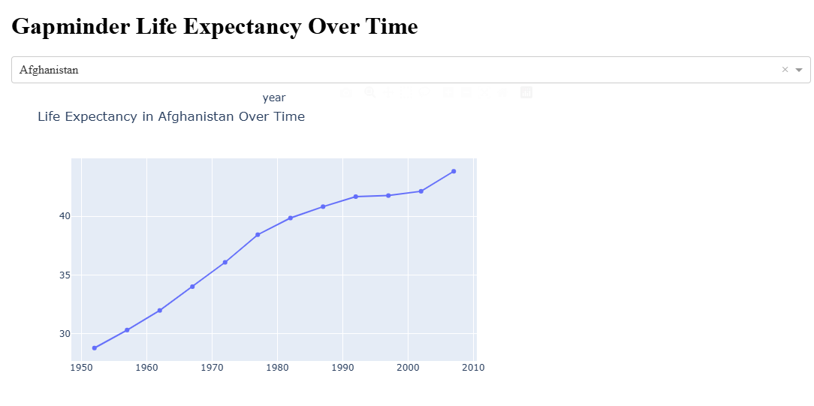

Slide 55
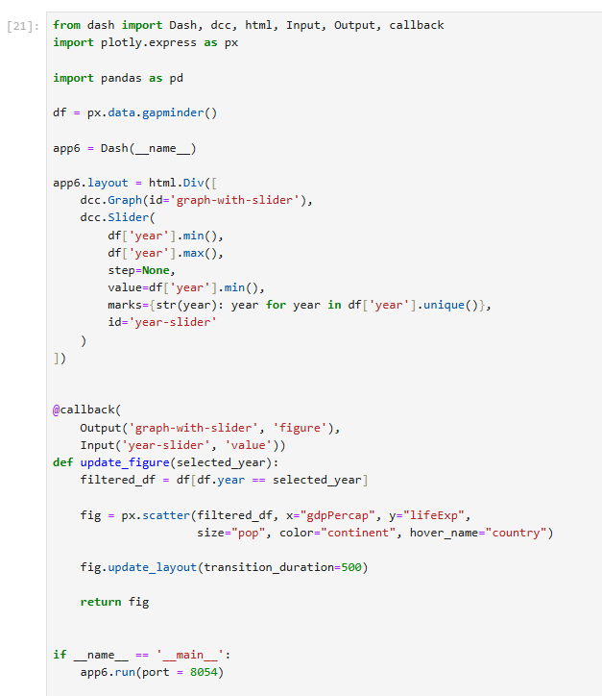
One input

Slide 56
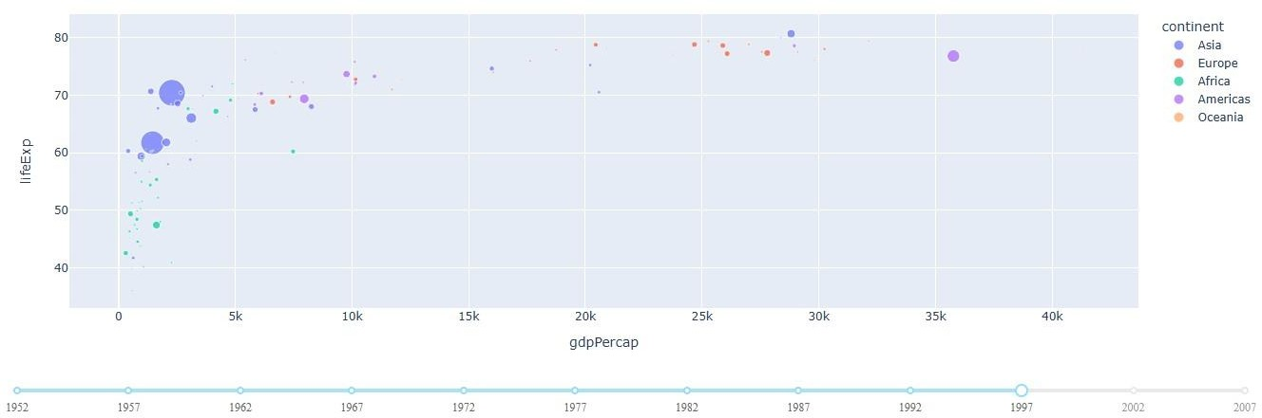

Slide 57
Using Multiple Inputs to Update Multiple Data Points

Slide 58
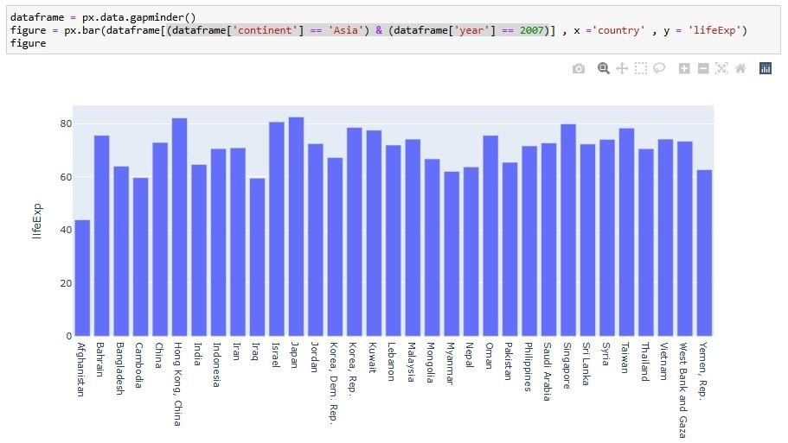
Multiple inputs

Slide 59
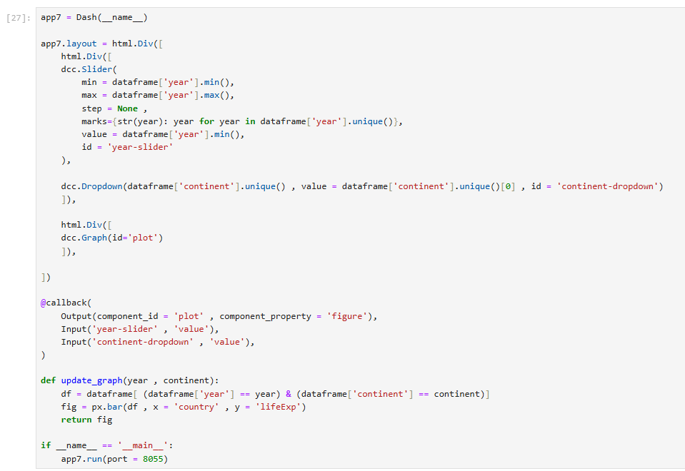
Example #2
4
1
2
3

Slide 60
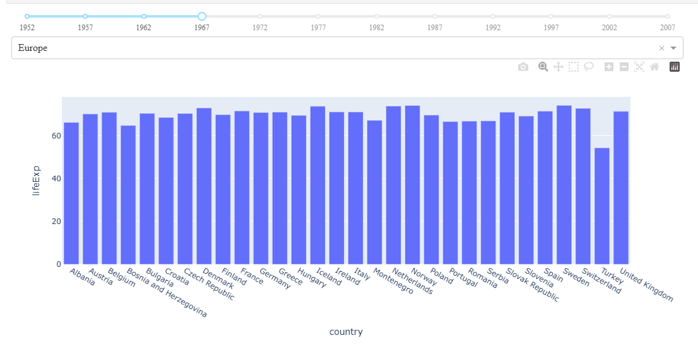

Slide 61
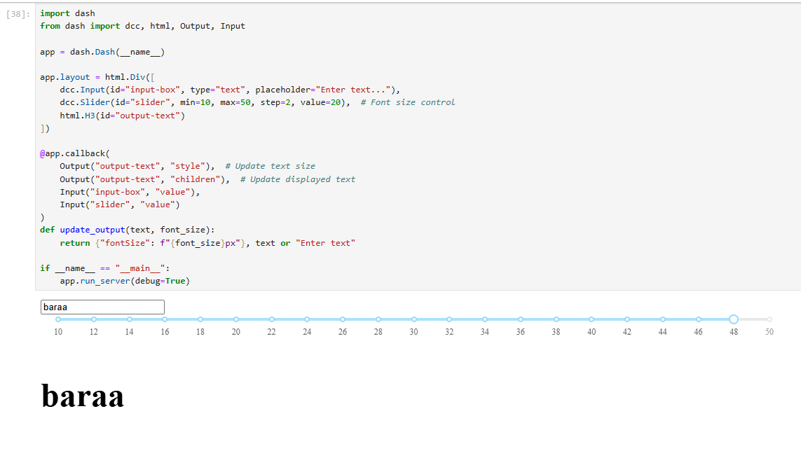
Using Multiple Inputs to Update Multiple Data Points
A callback function in Dash can take multiple inputs and update multiple elements in the UI.
Example #1

Slide 62
Using Multiple Outputs in Dash Callbacks

Slide 63
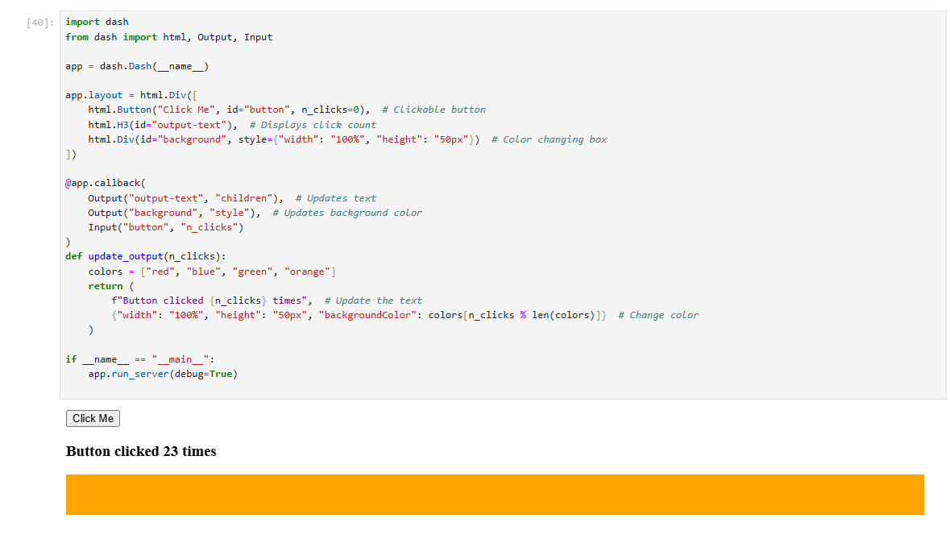
Using Multiple Outputs in Dash Callbacks
Example #1
Example #1
A single callback function in Dash can update multiple components at the same time.

Slide 64
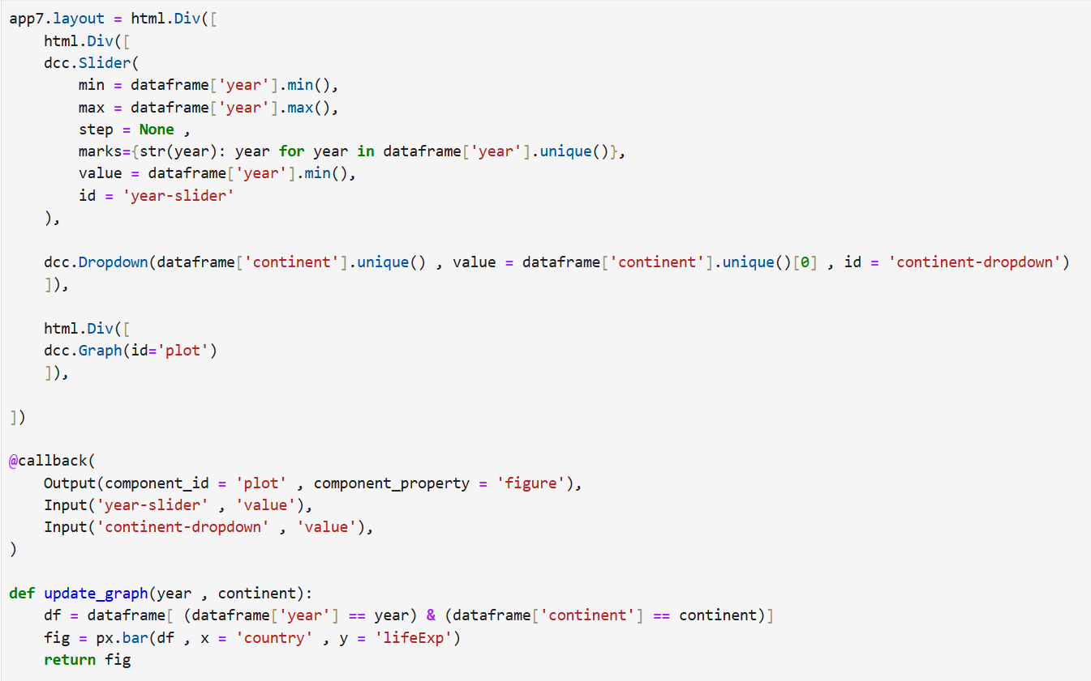

Slide 65
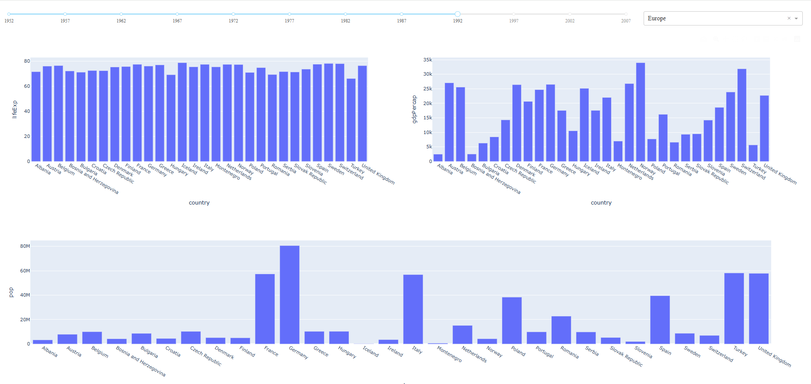

Slide 66
Tasks in classroom

Slide 67
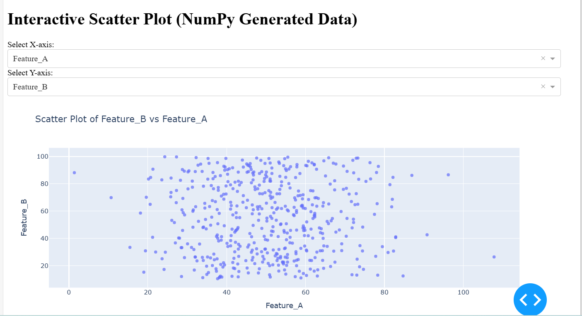
Task 4 output: Interactive Scatter Plot with User Controls using NumPy & Dash

